Slide 1
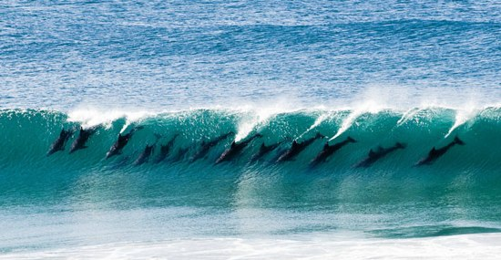
Sarah Jones, National Geographic
LAUSD, July 30, 2014
Tina Cheuk
Stanford University, ell.stanford.edu
tcheuk@stanford.edu
Convergences and Relationships in the New Standards: Argumentation, Reasoning, and Evidence
Notes:
I choose this image to be my opening slide because as a former school leader, I know that one of big goals is to get your team to move in the same direction so that your students can be college and career ready. I think of the new standards as this big wave with multiple ripples washing ashore– this initial wave is pretty big, it’s easy to get inundated and lost, and pulled out in multiple directions. And it can be challenging to get your teachers to be rallied around the same focus at the grain size of teaching and learning. Hopefully, in the next hour and a half, I can convince you to look at the standards in a new light, examine the convergences and relationships across the standards, and learn more about the practice of argumentation, reasoning and evidence.

Slide 2
66 pages of CCSS ELA/Literacy
93 pages of CCSS Mathematics
325 pages of NRC Science Framework
& more recently…
324 pages of NGSS
145 pages CA ELD Standards
Notes:
You don’t have an easy task. There are a LOT of standards. Each line of standard could then be expanded into lessons and units. It’s not a piece of literature. It’s written in this odd standards jargon–. These standards are what you would call a piece of “complex” text. As I was reading these standards (including the science framework), a couple of sections stood out for me.

Slide 3
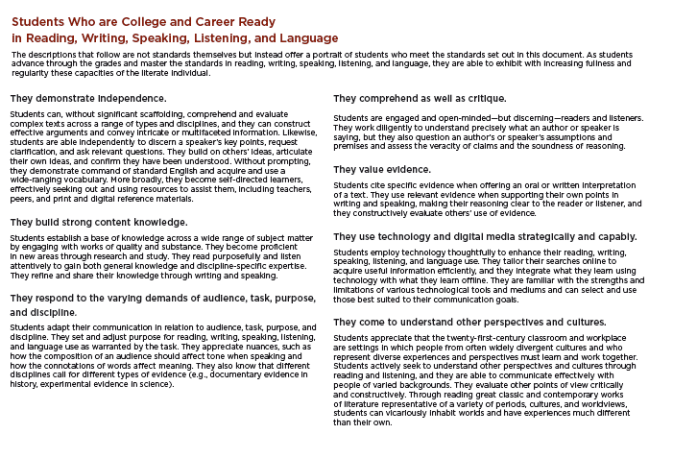
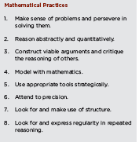
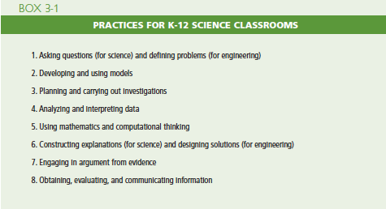
CCSS-Math Practices, p. 6-8
CCSS-ELA/Literacy “capacities”, p. 7
Science Framework-Science & Engineering Practices, p. 41-82
(chapter 3)
Notes:
Specifically, these pages stood out:
page 7 of ELA/Literacy Standards where they talk about the “portrait of students” and describe a set of student “capacities”
pages 6-8 of the math standards, where they discuss the meanings behind each of the 8 mathematical practices.
and chapter 3 of the Science Framework where they discuss the 8 science and engineering practices.
Three things stood out for me.
(1) the readable of these pages and how it visualized what college and career ready students would look like in the classroom.
(2) there are shared words (or terminology) across these standards as well as the common language of student practices in each of the disciplines.
(3) these practices are LANGUAGE intensive. Especially in our work with ELLs, we recognized this is a great window of opportunity to focus on how language and literacy development goes hand in hand in supporting disciplinary learning.
3. These practices do NOT stand alone– that is, they work simultaneous with the content standards. It’s not just about WHAT students know, but HOW they can demonstrate their knowledge. And the only way students can SHOW what they they know is through LANGUAGE practices.

Slide 4
ELA, Math, and Science/Engineering student practices
ELA* | Math | Science/Engineering
1. Support analysis of a range of grade level complex texts with evidence 2. Produce clear & coherent writing in which the development, organization, and style are appropriate to task, purpose, and audience. B 3. Construct valid arguments from evidence & critique the reasoning of others 4.Build and present knowledge through research by integrating, comparing, and synthesizing ideas from texts. 5.Build upon the ideas of others and articulate their own when working collaboratively. 6. Use English structures to communicate context specific messages 7. Use technology and digital media strategically and capably. | 1. Make sense of problems and persevere in solving them 2. Reason abstractly and quantitatively 3. Construct viable arguments and critique the reasoning of others 4. Model with mathematics 5. Use appropriate tools strategically 6. Attend to precision 7. Look for and make use of structure 8. Look for and express regularity in repeated reasoning | 1. Ask questions (for science) and define problems (for engineering) 2. Develop and use models 3. Plan and carry out investigations 4. Analyze and interpret data 5. Use mathematics and computational thinking 6. Construct explanations (for science) and design solutions (for engineering) 7. Engage in argument from evidence 8. Obtain, evaluate, and communicate information
Notes:
So initially, I just listed the practices in columns and in red, noticed the common language and theme of argumentation, reasoning with evidence.

Slide 5
Reading Standards for Literacy in History/SS, Science, and Technical Subjects 6–12 (CCSS)
Cite specific textual evidence to support analysis of science and technical texts…
…summarize complex concepts, processes, or information…paraphrasing them in simpler but still accurate terms.
Follow precisely a complex multistep procedure…; analyze the specific results based on explanations…
Analyze how the text structures information or ideas into categories or hierarchies, demonstrating understanding…
Analyze the author’s purpose in providing an explanation, describing a procedure, or discussing an experiment in a text, …
Integrate and evaluate multiple sources of information …
Evaluate the hypotheses, data, analysis, and conclusions in a science or technical text …
Synthesize information from a range of sources …
Notes:
Then, I look closely at the reading and writing standard for literacy in history/SS, science, and technical subjects for grades 6-12. In blue, are additional language practices– many of which are focused around the analysis, and evaluation of evidence as well as understanding the claims made by the source or author.

Slide 6
Writing Standards for Literacy in History/SS, Science, and Technical Subjects 6–12 (CCSS)
Write arguments focused on discipline-specific content.
Write informative/explanatory texts, including the narration of historical events, scientific procedures/ experiments, or technical processes.
Conduct short as well as more sustained research projects to answer a question (including a self-generated question) or solve a problem; narrow or broaden the inquiry when appropriate; synthesize multiple sources on the subject …
Gather relevant information from multiple authoritative print and digital sources …
Draw evidence from informational texts to support analysis, reflection, and research.
p. 65-66 CCSS-ELA Standards
Notes:
Similarly in the writing standards, there is a big focus on arguments, sources, and evidence.

Slide 7
Notes:
So I took all of these pieces of information and created this Venn Diagram– which you have as one of your handouts.
ACTIVITY 1:
Before I talk more about this– find a partner either from your school, or a colleague from another school. Introduce yourself if you don’t know each other already- and come up with.. [CHANGE slide]

Slide 8
One key takeaway.
One question you have.
Notes:
ONE key takeaway from this graphic (put on notecard)
ONE question you have (put on the other side notecard)
Share your takeaways and questions with each other.
Shared language
Professional learning time at your site and district, and networks
What stands out– language production for students across all content
In this talk, we’re going unpack the center overlap. Of argumentation, reasoning and evidence in complex texts.

Slide 9
Takeaways
Argument and reasoning from evidence is shared across the disciplines
Language intensive practices
Building disciplinary understanding and knowledge around complex texts
Potential for cross-disciplinary collaborations
Common language but perhaps different usages and processes within disciplines
Notes:
Some takeaways from this diagram– and this is not all inclusive.
The practice of argumentation and reasoning from evidence is shared across the disciplines.
These practices are LANGUAGE intensive. This is HOW students show WHAT they know.
Other takeaways from this diagram include the potential of collaborations to happen across disciplines. You may want to think about how you want to utilize ELD time as well as the role of the ELD teacher or specialist at your site. Language development isn’t just relegated to the role of ELLs, or in the ELD block– but ALL students will need to learn these language practices.
And lastly, while the language and the terminology is the same, the usages and processes used within each discipline may vary.
For the remainder of the hour, we’re going to go more deeply into these points and I’m hoping by the end of the presentation, you’ll have both the sense of the big picture around argumentation, reasoning and evidence as well as a more nuanced look at what this means in each of the three major disciplines (ELA, Math and Science). So lets dive in!

Slide 10
What is argument?
Argument is… | Comments:
a disagreement.
a conflict.
a confrontation.
an explanation.
an understanding.
a line of reasoning.
a proposition.
a negotiation.
(Other suggestions/thought)
Task adapted from IDEAS curriculum.
Notes:
Let’s first unpack this term “argument” that shows up across the content area standards.
There are many different perceptions of argument. Which of the ones below most similar to the way in which you think about argument?
1. Take 1 minutes to do this exercise by yourself. Add any other ideas…
2. In pairs or group of 3, compare answers with one another noting points of agreement and disagreement.
----
Let’s bring this back together.
I heard a lot of rich discussion- some agreement, and disagreements in the meaning of this term. We come in with different experiences and understandings as to what the term argument means. Through out this morning session, continue to think about how these various meanings may be problematic for your content area teachers, and opportunities where your team can learn from one another.

Slide 11
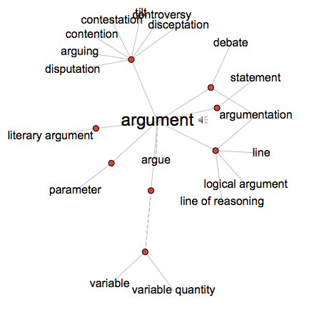
visualthesaurus.com
Notes:
Again, here’s another example of common associations related to the word “argument” using the visual thesaurus application. The main point I’m trying to drive home is that your teachers will come in with their understanding of what argument means for them and in their disciplines. Part of your role as instructional leaders is to help your staff understand each other and grow your collective understanding so your students don’t get confused! So let’s dive in and see what argumentation and reasoning with evidence looks like in math.

Slide 12
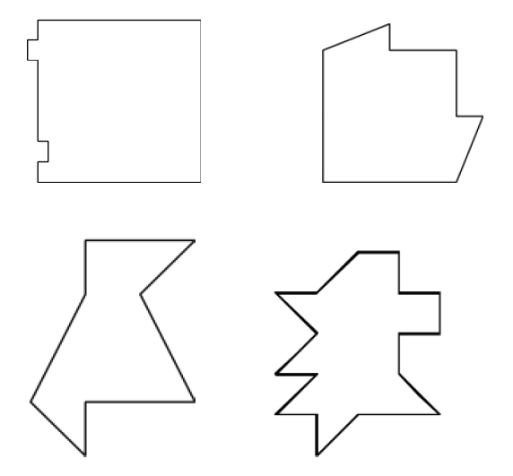
Crazy Cakes (grade 3)
Divide each of the cakes below into two parts with equal area.
Be able to explain your reasoning to your partner.
A
B
C
D
MP3. Construct viable arguments and critique the reasoning of others.
3MD5. Recognize area as an attribute of plane figures and understand concepts of area measurement.
3MD7. Recognize area as additive.
Notes:
Please turn to your handouts to the page that has the “Crazy Cakes” diagram.
Here’s an example task for grade 3 mathematics that address practice standard 3 “Construct viable arguments and critique the reasoning of others” and Measurement and Data content standards 5 and 7.
The task asks the following: “Divide each of the cakes below into two parts with equal area.”
What I would like you to do, is spend the first 2 minutes and work on this task yourself. Then in pairs, explain your reasoning to your partner.
And then we’ll recap and take a look at what this looks like in a classroom setting.

Slide 13
MP3. Construct viable arguments and critique the reasoning of others.
Mathematically proficient students at the elementary grades construct mathematical arguments—that is, explain the reasoning underlying a strategy, solution, or conjecture—using concrete referents such as objects, drawings, diagrams, and actions. . . . Mathematically proficient students can listen to or read the arguments of others, decide whether they make sense, ask useful questions to clarify or improve the arguments, and build on those arguments.
Notes:
So what most of you just engaged in was math practice #3 (construct viable arguments and critique the reasoning of others) at the elementary level–
Here is an excerpt of the practice and I’ve highlighted what may of you were practicing–
For math, at the elementary and middle school level, the focus is on reasoning with evidence. At the high school level math, argumentation is defined as more formal proofs.
(Side note): conjecture=proposition that is unproven; an opinion or idea formed without proof or sufficient evidence.

Slide 14
Crazy Cakes (grade 3)
http://vimeo.com/66201779
Aneschka and Kayla video (Crazy Cakes)
How are the students using language to express their reasoning to each other?
What is the teacher doing?
http://vimeo.com/66201779 (from Illustrative Mathematics)
Notes:
So let’s take a look at what this looks like in a classroom setting with two students, Aneschka and Kayla.
This task calls upon a number of skills: Students must recognize area as an attribute of plane figures and recognize that area is additive. They must be able to decompose figures and identify congruent shapes within the figure. Some of the students’ methods might depend on identifying square units, using symmetry, and/or finding pairwise congruent shapes.
Because students might base their solution strategies on different basic principles, this is an ideal context in which students can present arguments to justify their solutions and strategies. This video is about 5 minutes long.
As you are watching and listening, think about these two questions:
How are the students using language to explain their reasoning to each other?
What is the teacher doing?

Slide 15
What do you see and hear?
How are students using language to express their reasoning and understanding of the task?
What are some of the teacher moves that support students’ reasoning?
Notes:
Let’s take a moment and share out your thoughts with a partner regarding these two questions. [3 minutes]
A couple of comments on this video:
In this case, when students develop arguments to justify their solutions, it is their responsibility to explain it to classmates so they understand. Similarly, it is the responsibility of the class to try to make sense of the argument and to ask questions until they understand it.
In this video segment, Aneschka, presents her solution to the class and offers her argument and justification. But not all of her classmates understand her reasoning. The teacher recognizes the soundness of the reasoning and offers suggestions to help Aneschka clarify her argument to the class. Aneschka keeps working to convince her classmates until they recognize that she is correct. Here, you also see students comment on what helped them understand.
(SKIP-for time)
The class also recognizes that Kayla is not yet convinced. Kayla has presented an objection which the teacher and Aneschka recognize is not relevant to the argument. The teacher registers Kayla’s conceptual misunderstanding (regarding congruency) and encourages alternative explanations to the problem and more time for Kayla to consider this line of reasoning.
I want to touch a little bit on assessment– and the next couple of slides is just to highlight how the Smarter Balanced assessment items will address this math practice.

Slide 16
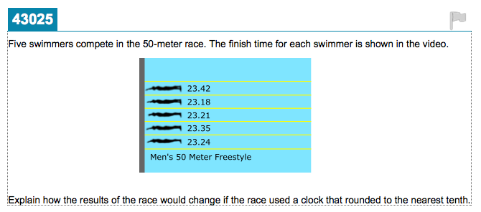
Sample SBAC-math task, grade 5
Notes:
I want to touch a little bit on assessment– and the next couple of slides is just to highlight how the Smarter Balanced assessment items will address this math practice.
I do think the new SBAC assessment come closer assessing college and career readiness skills better than the STAR tests. If students have having regular of practice engaging in the type of academic discourse that you all were engaged in just earlier, they should be ready for these new summative assessments.
Here’s an example task for grade 5. Notice that students are asked to “EXPLAIN… the results….”

Slide 17
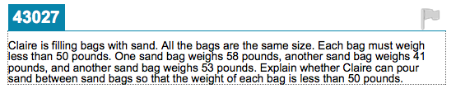
Sample SBAC-math task, grade 8
Notes:
Here is an example for grade 8, Again, students are asked to EXPLAIN whether Claire can pour sand between the sandbags…
Notice how the text of the math problem becomes increasingly more complex in grade 8.

Slide 18
SBAC Sample Task, HS.
Explaining flawed reasoning
The noise level at a music concert must be no more than 80 decibels (dB) at the edge of the property on which the concert is held.
Melissa uses a decibel meter to test whether the noise level at the edge of the property is no more than 80 dB.
Melissa is standing 10 feet away from the speakers and the noise level is 100 dB.
The edge of the property is 70 feet away from the speakers.
Every time the distance between the speakers and Melissa doubles, the noise level decreases by about 6 dB.
Rafael claims that the noise level at the edge of the property is no more than 80 dB since the edge of the property is over 4 times the distance from where Melissa is standing. Explain whether Rafael is or is not correct.
Notes:
And LASTLY, here’s a high school math example– where students have to explain flawed reasoning– “explaining whether Rafael is or is not correct.” The big shift in math is that it’s not about getting the RIGHT answer– but understanding and sharing your own line of reasoning, understanding the misconceptions and flawed reasoning of your classmates, and helping them to develop. These math practices actually foster greater classroom collaboration.
Notice this task here is filled with language. For your English learners, it’s very important that your math teachers don’t simplify the language of the task as a form of scaffolding. By simplifying, you’re changing the nature of the task and dialing down the complexity of the task. ELs have to be given the opportunity to wrestle with grade level complex texts– otherwise, they are never going to be college and career ready.

Slide 19
Notes:
Let’s shift course a little bit and look at the term EVIDENCE that converges at the center of the Venn Diagram. The next portion of this session will focus on what evidence means in ELA, history/SS, and Science.

Slide 20
What is evidence?
Evidence is… | Comments (as it relates to ELA, Science, and History/SS):
data.
a fact.
a theory.
logical.
information.
an appeal.
objective.
a claim.
verifiable.
(Other suggestions/thought)
Notes:
On your handout, turn to the page where it’s titled “What is evidence?”
Again, there are many different meanings to the term “evidence.” I want you to position yourself as a content area teacher (ELA, Science, and History/SS).
In pairs or a group of three take 5 minutes to discuss what evidence means in the role of a content area teacher you’ve selected.
Discuss some of the ways evidence is described here… (in your role as a content area teacher)
Feel free to generate additional suggestions.
What kind of problem does this pose for your content area teachers?
Commentary:
We come in with different experiences and understandings as to what evidence means in the various disciplines–the meaning of this term is content dependent.

Slide 21
Evidence: ELA, History, & Science
ELA: Textual evidence to justify and support claims about the text.
History/SS: Sources & records offer evidence, assertions may or may not be true.
Science: Objective, unbiased, and verifiable; consensus with scientific community
Notes:
This is still a high level summary, but here are some key highlights of the differences in each discipline:
In ELA, the focus is really around getting students to be familiar with textual evidence, to justify and support claims about a text.
Remember that CCSS ELA standards INCLUDE for grades 6-12 literacy in history/SS, science and technical subjects. So ELA teachers have a heavier lift as they may not necessarily be experts in the content areas of history/SS, science, and technical subjects– BUT they do need to understand the nuances of how evidence is played out in various disciplines. Here is an opportunity for your teachers to learn from each other.
A couple of comments on history and science. Historical records and sources offer evidence, but their assertions may or may not be true. To judge what likely happened, students have to understand those records and sources. They have to analyze that evidence, and decide what to believe.
Lastly, evidence in science are typically described as objective, unbiased and verifiable– with consensus with the scientific community. (we’ll get to look at an example at the end.)

Slide 22
A New MC Format for CCSS-Aligned Assessment – Calling for Use of Textual Evidence (Grade 3)
CCSS-Evidence-Based Selected-Response (EBSR) Aligned Item
Part A: What is the main reason that Jack wants the canoe to be a success? He wants to feel that he is independent of his father. He thinks the canoe will impress his father.* He wants to be able to travel deep into the swamp without his father. He wants to show his father that he can paddle a canoe as well as a grown-up. Part B: Which detail from the passage best supports the answer to Part A? “And I wasn’t in just any old canoe, but one I made myself.” “It was tough paddling, but L’tle Possum was amazing. She turned on a nickel and answered every haul and draw of my paddle.” “She rocked to the right and came back. I stood up and rocked her again. She did not dump.” “I’m not good at technical things like Dad is, but after I tested L’tle Possum, I felt that he might think I had done a four-star job—maybe even five.”*
(Grade 3 item based on an excerpt from Tree Castle Island by Jean Craighead George)
RL.3.3: Describe characters in a story (e.g., their traits, motivations, or feelings) and explain how their actions contribute to the sequence of events. RL.3.1: Ask and answer questions to demonstrate understanding of a text, referring explicitly to the text as the basis for the answers.
Notes:
So let’s take a look at some sample SBAC tasks that they call “Evidence-Based-Selected Response” item.
This two-part item type developed specifically in response to the Common Core emphasis on use of textual evidence.
Here, students have to analyze the text, and come up with the claim for part A and for part B, they are asked to identify textual evidence to back up their analysis or claim in part A.

Slide 23
A New MC Format for CCSS-Aligned Assessment –
Calling for Use of Textual Evidence (Grade 5)
CCSS-Aligned Item
Part A: What does “circulate” mean as used in paragraph 2? Get stronger Gather together Break down Travel around* Part B: Which words from the passage best help the reader understand the meaning of “circulate”? “must first be digested” “through your arteries to your muscles”* “another set of membranes” “look for a cluster of them, and watch closely”
(Grade 5 item based on an article titled “Bubblology,” from an online site “Science for Kids”)
RI.5.4: Determine the meaning of general academic and domain-specific words and phrases in a text relevant to a grade 5 topic or subject area. RI.5.1: Quote accurately from a text when explaining what the text says explicitly and when drawing inferences from the text.
Notes:
Here’s a 5th grade example. Part B asks students to determine which set of words in the text best gives context for the meaning of circulate, again illustrating the standards’ emphasis on use of textual evidence.
Note that in part B, the vocabulary test questions is meant to ensure that students are rewarded less for their prior knowledge and more for their use of context—and evidence presented within the text.

Slide 24
A New MC Format for CCSS-Aligned Assessment –
Calling for Use of Textual Evidence (Grade 9)
CCSS-Aligned Item
Part A: In the first three paragraphs of the story, what is a theme that is developed by details about the setting? The townspeople’s desires are very different from George’s. It is a time of new beginnings.* The town is not likely ever to change. It is hard to survive in a rural environment. Part B: Which two details from the passage support the theme in Part A? “It was April and the young tree leaves were just coming out of their buds.”* “The boy who slept in the hotel office lay on a cot by the door. His mouth was open and he snored lustily.” “The east was pink with the dawn and long streaks of light climbed into the sky where a few stars still shone.”* D., E., & F. [The remaining distractors are not shown.]
(Grade 9 item based on a short story from Sherwood Anderson’s novel Winesburg, Ohio.)
RL.9.2: Determine a theme or central idea of a text and analyze in detail its development over the course of the text, including how it emerges and is shaped and refined by specific details; provide an objective summary of the text. RL.9.1: Cite strong and thorough textual evidence to support analysis of what the text says explicitly as well as inferences drawn from the text.
Notes:
Lastly, there’s a grade 9 example with part A and B. In part A, students need to analyze and figure out the claim (in this case, the theme) made by the text, and in part B, students are asked to identify two details (or pieces of evidence) that support their claim in part A.

Slide 25
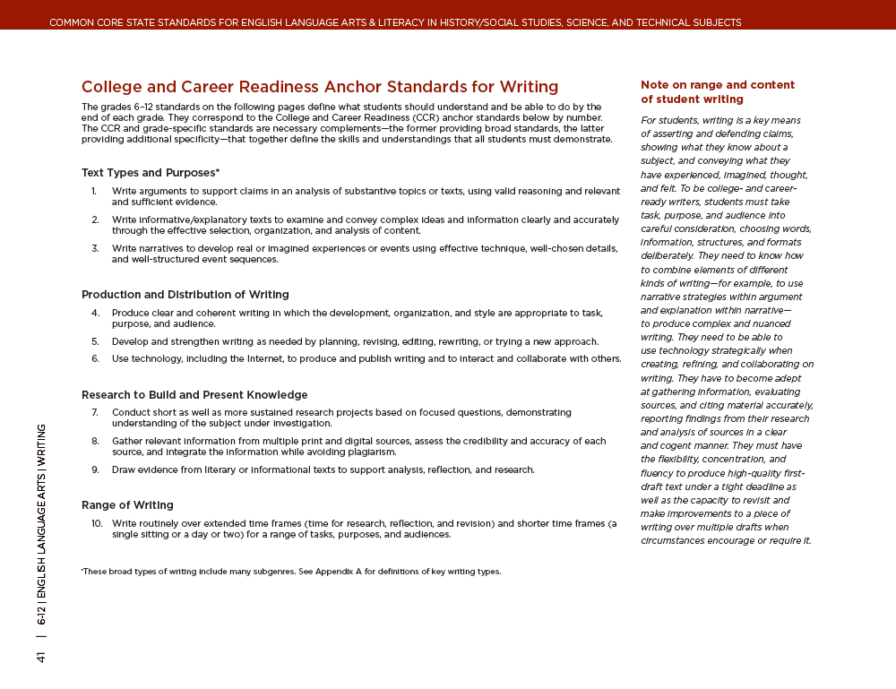
Argumentative Writing Anchor Standard 1:
CCR Anchor Standard for Writing Arguments:
1. Write arguments to support claims in an analysis of substantive topics or texts, using valid reasoning and relevant and sufficient evidence.
Page 41 of CCSS-ELA/Literacy
Notes:
Let’s briefly look at what this means for student writing.
Anchor standard 1 for grades 6-12 states: “Write arguments to support claims in an analysis of substantive topics or texts, using valid reasoning and relevant and sufficient evidence.”
What does this mean?

Slide 26
Argumentative writing
CCR Anchor Standard #1 for Writing:
Write arguments to support claims in an analysis of substantive topics or texts, using valid reasoning and relevant and sufficient evidence.
One “reading” of the standard:
Argumentative writing analyzes complex texts to support a thesis in an organized way using relevant evidence and sufficient reasoning.
Notes:
One can translate that standard as the following: “Argumentative writing analyzes complex texts to support a thesis in an organized way using relevant evidence and sufficient reasoning. Let’s take a look at a couple of examples.

Slide 27
Comparing Traditional Assessment to CCSS Assessment – Writing to Sources (grade 9)
Traditional Brief Constructed-Response Question | CCSS-Aligned Brief Constructed-Response Question
Based on your knowledge of modern dance, do you agree that dance is a symbol of the performance of living? Explain why or why not. | In her interview, how does Graham introduce and develop the argument that dance is the symbol of the performance of living?
(Grade 9 aligned item based on “An Athlete of God,” a radio interview with Martha Graham.)
RL.9.3: Analyze how the author unfolds an analysis or series of ideas or events, including the order in which the points are made, how they are introduced and developed, and the connections that are drawn between them. RL.91: Cite strong and thorough textual evidence to support analysis of what the text says explicitly as well as inferences drawn from the text. W.9.2: Write informative/explanatory texts to examine and convey complex ideas, concepts, and information clearly and accurately through the effective selection, organization, and analysis of content. W.9.9: Draw evidence from literary or informational texts to support analysis, reflection, and research.
Notes:
Here is a pair of brief constructed-response questions at the 9th grade level
On the left side, is a pretty common type of task students are used to responding to– it asks them to take a side of an issue and more often then not, use information from outside the text as evidence.
In the CCSS-aligned item, student will be asked to show their understanding of the text by analyzing the author’s ideas—staying inside the text.

Slide 28
Comparing Traditional Assessment to CCSS Assessment – Writing to Sources (grade 11)
Traditional, De-contextualized Writing Prompt | CCSS-Aligned Writing Prompt
Write a letter to your school principal in which you argue for or against the idea of increasing the budget of the school football team. | In his inaugural address, Thomas Jefferson directly or indirectly refers to several freedoms that Americans enjoy. Explain which freedoms Jefferson sees as most important for the success of the new nation and explain why they are important. Support your response with evidence from the address.
(Grade 11 aligned item based on an excerpt from Jefferson’s Inaugural Address, 1801)
W.11.1: Write arguments to support claims in an analysis of substantive topics or texts, using valid reasoning and relevant and sufficient evidence. W.11.9: Draw evidence from literary or informational texts to support analysis, reflection, and research.
Notes:
Again, here’s another example in grade 11. With the common core,
In writing to sources, students analyze texts, make claims or inferences, and draw on the text itself for evidence. When students are given rich, complex texts, they can write rich essays that better exemplify the kind of writing needed for college and careers, requiring use of textual evidence and thus leveling the playing field. The CCSS-aligned item requires students to closely examine what Jefferson is saying and make significant claims about the text.
I don’t want to leave out science– the last topic of the day--

Slide 29
Science & Engineering Practice 7: Engaging in Argument from Evidence
In science, reasoning and argument are essential for identifying the strengths and weaknesses of a line of reasoning and for finding the best explanation for a natural phenomenon.
Scientists must defend their explanations, formulate evidence based on a solid foundation of data, examine their own understanding in light of the evidence and comments offered by others, and collaborate with peers in searching for the best explanation for the phenomenon being investigated.
NRC Science Framework, p.52
Notes:
I don’t want to leave out science– this is our last topic of the day– and here’s how this practice– engaging in argument from evidence is described in the NRC K-12 science framework. Let’s take a moment and see how this practice plays out with a science task.

Slide 30
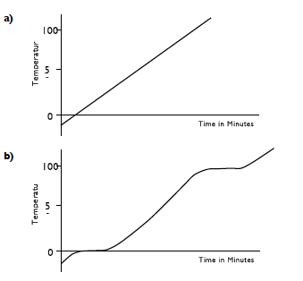
Heating Ice to Steam (Middle School)
Alex and Beatrice are studying the physical and chemical properties of water. Alex thinks diagram A is the correct representation of heating ice to steam. Beatrice thinks diagram B is the correct representation.
Why does Alex think he is correct?
Why does Beatrice think she is correct?
Temperature (°C )
Temperature (°C )
Notes:
Here’s an example of a science task for middle school students. Turn to the last page with task in your handout.
Alex and Beatrice are studying the physical and chemical properties of water. Alex thinks diagram A is the correct representation of heating ice to steam. Beatrice thinks diagram B is the correct representation.
Why does Alex think he is correct?
Why does Beatrice think she is correct?

Slide 31
Examples of evidence that may be helpful in your argument…
Ice will melt when it is heated and turns into water.
In solids, there are bonds between the particles that hold them together in a fixed shape.
When you heat a substance the supply of heat energy is usually constant.
Energy is needed to break bonds between particles.
Ice melts at 0°C and water boils at 100°C.
When energy is being used to break bonds between particles, there will be no temperature change,
When substances are heated, the particles in them absorb heat energy and move about more quickly.
Notes:
On the back, I’ve provided some examples of evidence that may be helpful in formulating your argument.

Slide 32
What challenges do you anticipate your STUDENTS will have
in the practice of argumentation and reasoning from evidence?
Notes:
What challenges do you anticipate your STUDENTS will have in the practice of argumentation and reasoning from evidence? DISCUSS with your colleagues and we’ll come back to share out.

Slide 33
Challenges for students
Students making inaccurate generalization or claim based on their limited information.
Uncertain about uncertainty (not having a “right” answer.)
Failure to justify the “evidence” used to support their claim, declaring their data proves their claim.
Students struggle when asked to evaluate claims made by others.
  Considered “disrespectful” to argue or disagree with others (cultural)
  Peer relationships and classroom dynamics.
Teacher or friends reveal the “right” answer.
Rather than arguing from evidence, personal experiences or beliefs are used to support or challenge an idea.
Sampson, Enderle, & Grooms, Argumentation in Science Education.

Slide 34
What challenges do you anticipate your TEACHERS will have
in teaching
argumentation and reasoning
from evidence?
Notes:
Take a moment and share your thoughts on this question with your colleague--

Slide 35
Challenges for teachers
Uncertain about uncertainty (may not be able to anticipate student responses)
Takes more time (preparation and implementation)
Not sure what and how to evaluate
Support student questioning of others (whether for clarification or argument)
Managing student “air time”; creating a culture of academic discourse; all voices contribute

Slide 36
Final Takeaways
Culture of citing evidence. Honor evidence.
  “What is the evidence (in the text) for your answer?”
Worthy tasks: What are students asked to do?
  How are students developing their language and literacy skills in the content areas?
Build a culture of academic discourse.
  How do you create safe places for discussion and DISAGREEMENTS to happen in classrooms?
  What are classroom and school norms? How are adults modeling this practice?
Notes:
Number one, is to build a culture of citing evidence in the classroom when you write and speak about texts.
“Where’s the evidence in the text for your answer?
Number two, What are students asked to do? Are the task they are doing worthy? Are they wrestling with authentic, complex texts?

Slide 37
Resources in Mathematics
Illustrative Mathematics
https://www.illustrativemathematics.org/MP3
Elaborations of the practices, tasks with annotations, and videos, K-12.
Inside Mathematics
http://www.insidemathematics.org
Videos, tasks with annotations, K-12 organized by the 8 math practices.

Slide 38
Resources in ELA & History/SS
Achieve the CORE- ELA complex texts, tasks, and sample student work
http://achievethecore.org
Assessment questions (grades 3-11) organized by the 3 shifts.
Denver Public Schools (Standards Toolkit)
Teaching argumentative writing using CCSS-ppt by David Pook.
http://standardstoolkit.dpsk12.org/2-literacy/2h-academic-types-of-writing-and-writing-from-evidence/
CCSS-ELA & Literacy, Appendix C
34 samples of student writing (K-12), opinion, informative/explanatory, narrative, and argument.
Reading Like a Historian, Stanford
http://sheg.stanford.edu/
Intro materials includes lessons and units around evaluating sources, tools for close reading of complex primary texts, and corroborating evidence (high school).

Slide 39
Resources in Science
A Framework for K-12 Science Education: Practices, Crosscutting Concepts, and Core Ideas
Pages 71-74, Engaging in argument from evidence.
IDEAS (IDeas, Evidence, & Argument, in Science) National STEM Centre, King’s College, London
http://stem.org.uk/rx8rt
Session 1: Introducing Argument
Session 2: Managing Small Group Discussions
Session 3: Teaching Argument
Session 4: Resources for Argumentation
Session 5: Evaluating Argument
Session 6: Modeling Argument

Slide 40
Language tools : questions, sentence frames & transitions
What mathematical evidence would support your solution?
How can we be sure that...? / How could you prove that...?
Will it still work if...?
What were you considering when...?
How did you decide to try that strategy?
How did you test whether your approach worked?
How did you decide what the problem was asking you to
find? (What was unknown?)
Did you try a method that did not work? Why didn’t it
work? Would it ever work? Why or why not?
What is the same and what is different about...?
How could you demonstrate a counter-example?
From LAUSD Common Core MATH Flip Book:

Slide 41
Language tools : questions, sentence frames & transitions
I don’t think the evidence supports _____ because …
I respectfully disagree with that statement because…
As evidence, I notice …
The data shows that …
The author/text reveals that …
I realize you | believe | but
I understand you | feel | yet
Even though you | maintain | however
Although you | want | I doubt
Some people | favor | I question
It may be that you | support | Let me explain …
On the contrary | argue | On the other hand …
Adapted from Durham Public Schools, http://literacy.dpsnc.net/five-pillars/writing/sentence-frames

Slide 42
Language tools : questions, sentence frames & transitions
Share Your Claim & Anticipate/Refute Potential Counterclaims
•While some people believe… I think…
•The way I see it,
•Based on… I have come to the conclusion that…
•In my opinion,
•There is ample evidence to suggest that…
Build on the Claims of Others
•So, what you’re saying is…
•I have also experienced what you describe when you claim that…
•What you said about… made me think of…
•That was a great point because…
•I agree with your argument there, because…
•That’s a fascinating point. It connects to what I was thinking about…
Respectfully Disagree with the Claims of Others
•I respect what you claim about…, however, in my opinion…
•You propose that… I’m going to have to disagree for the following reasons…
•You make a solid point about…, but the other side of it is…
•While you make a great point, I’m going to have to disagree because…
HOW PERSUASIVE ARE YOU IN AN ESSAY OR DEBATE?
Sometimes it’s not WHAT you say, but HOW you say it that really matters.
Adapted from Teaching Channel: https://www.teachingchannel.org/videos/using-socratic-seminars-in-classroom

Slide 43
Thank you!

